Slide 1


Department of BES-I
COURSE: Data Structures through Python
COURSE CODE: 24SC1204
Topic:
Name of the topic:
Graph Traversal - DFS
Session – 37

Slide 2



AIM OF THE SESSION
To familiarize students with the basic concept of DFS
INSTRUCTIONAL OBJECTIVES
This Session is designed to:
Demonstrate DFS
Apply DFS to Real-World Problems.
Compare and Contrast BFS and DFS.
Describe the each operation
List out the advantages and disadvantages with BFS and DFS.
LEARNING OUTCOMES
At the end of this session, you should be able to:
Define DFS
Describe the DFS and its operations
Summarize definition, and operations of DFS, its applications

Slide 3
DFS-(Depth First Search)
Depth first Search or Depth first traversal is a recursive algorithm for searching all the vertices of a graph or tree data structure. Traversal means visiting all the nodes of a graph.
A standard DFS implementation puts each vertex of the graph into one of two categories:
Visited
Not Visited
The purpose of the algorithm is to mark each vertex as visited while avoiding cycles.
The DFS algorithm works as follows:
Start by putting any one of the graph's vertices on top of a stack.
Take the top item of the stack and add it to the visited list.
Create a list of that vertex's adjacent nodes. Add the ones which aren't in the visited list to the top of the stack.
Keep repeating steps 2 and 3 until the stack is empty.

Slide 4
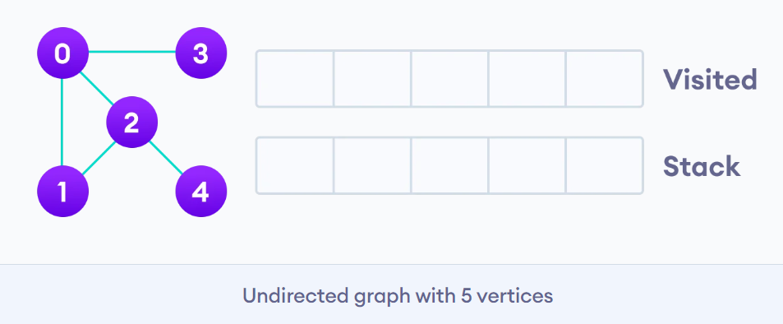
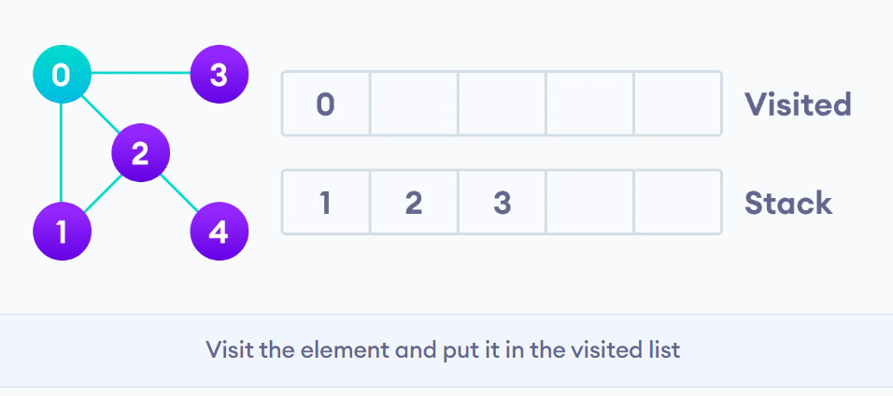
DFS Conti….
We start from vertex 0, the DFS algorithm starts by putting it in the Visited list and putting all its adjacent vertices in the stack.

Slide 5
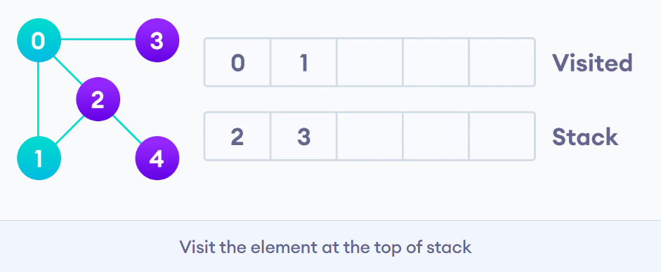
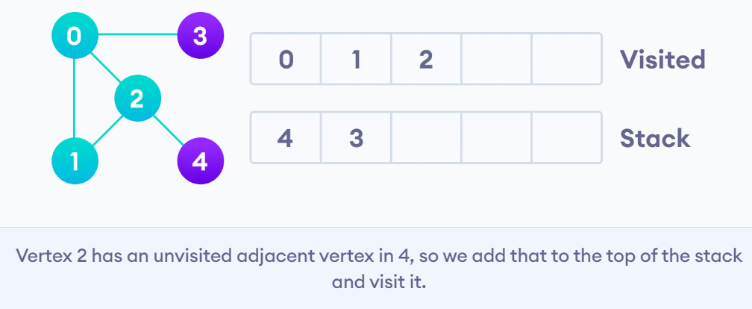
DFS Conti..
Next, we visit the element at the top of stack i.e. 1 and go to its adjacent nodes. Since 0 has already been visited, we visit 2 instead.
Vertex 2 has an unvisited adjacent vertex in 4, so we add that to the top of the stack and visit it.

Slide 6
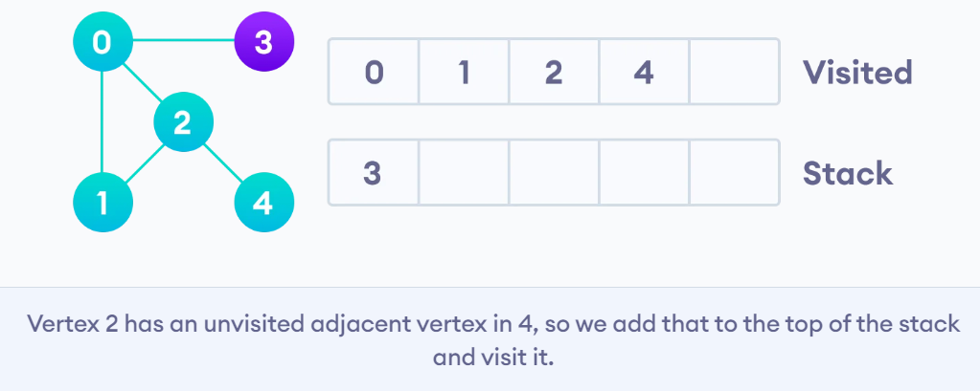
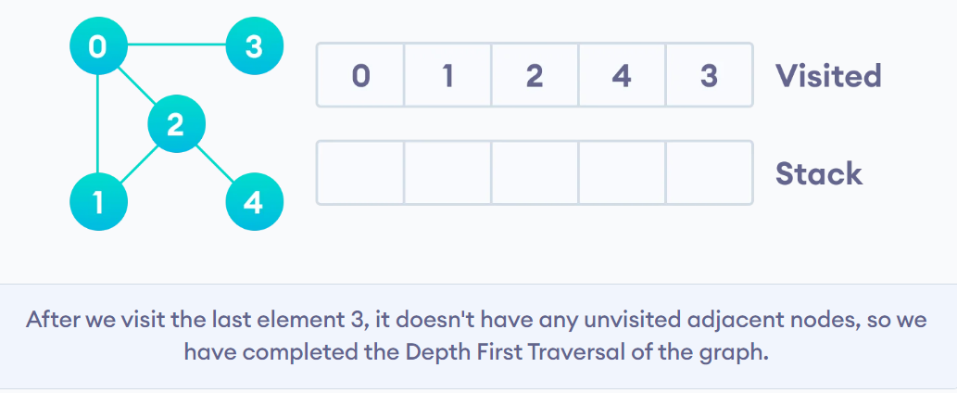
DFS Conti….
After we visit the last element 3, it doesn't have any unvisited adjacent nodes, so we have completed the Depth First Traversal of the graph.

Slide 7
IMPORTANT FACTS RELATED TO THE SESSION
DFS Algorithm Complexity
The time complexity of the DFS algorithm is represented in the form of O(V + E), where V is the number of nodes and E is the number of edges.
The space complexity of the algorithm is O(V).
Application of DFS Algorithm
For finding the path
To test if the graph is bipartite
For finding the strongly connected components of a graph
For detecting cycles in a graph

Slide 8
SUMMARY
DFS is a graph traversal algorithm that explores as far as possible along each branch before backtracking.
Start at a source node and explore as deeply as possible along each branch before backtracking.
Uses a stack (either explicitly or through recursion) to keep track of the nodes to visit.
Characteristics:
Non-optimal for finding the shortest path.
Can be implemented using recursion or an explicit stack.

Slide 9
SELF-ASSESSMENT QUESTIONS
Breadth First Search is equivalent to which of the traversal in the Binary Trees?
a) Pre-order Traversal
b) Post-order Traversal
c) Level-order Traversal
d) In-order Traversal
2. Traversal of a graph is different from tree because?
There can be a loop in graph so we must maintain a visited flag for every vertex
DFS of a graph uses stack, but inorder traversal of a tree is recursive
BFS of a graph uses queue, but a time efficient BFS of a tree is recursive.
All of the above

Slide 10
TERMINAL QUESTIONS
1. Describe the Depth First Search (DFS) in a graph or tree?
2. Describe the DFS algorithm work in a C program?
3. Can DFS be used to search in unweighted and weighted graphs?

Slide 11
REFERENCES FOR FURTHER LEARNING OF THE SESSION
TEXTBOOKS:
1. Mark Allen Weiss, Data Structures and Algorithm Analysis in C, 2010, Second Edition, Pearson Education.
2. Allen B. Downey, ”Think Python: How to Think Like a Computer Scientist’’, 2nd edition, Updated for Python 3, Shroff/O’Reilly Publishers, 2016 (http://greenteapress.com/wp/thinkpython/)
3. Data Structures and algorithms using python, 2011,Rance D, Necaise, himilton printing
REFERENCE BOOKS:
1. Data Structures and Algorithm Analysis in PYTHON, 2010, Mark Allen Weiss, Second Edition, Pearson Education.
2. Data Structures and Algorithms, A.V.Aho, J.E.Hopcroft, and J.D.Ullman, Pearson Education, First Edition Reprint2003.
3. Advanced Guide to Python 3 Programming, John Hunt, 4th Edition, Springer Nature Switzerland AG 2019.
4. Python Basics: A Practice Introduction to Python 3, David Amos, Dan Bader, Joanna Jablonski, Fletcher Heisler, 4th edition, Real Python..
WEB REFERNCES/MOOCS:
1. https://docs.python.org/3/tutorial/datastructures.html
2. https://www.w3schools.com/dsa/dsa_intro.php
3. https://www.geeksforgeeks.org/python-data-structures/

Slide 12
THANK YOU
Team – Data Sructures through Python

